Slide 1

Group 3
Software Manager: Dirk Thieme
Hardware Manager: Erik Manis
Project Controller: Mohammed Ansari

Slide 2
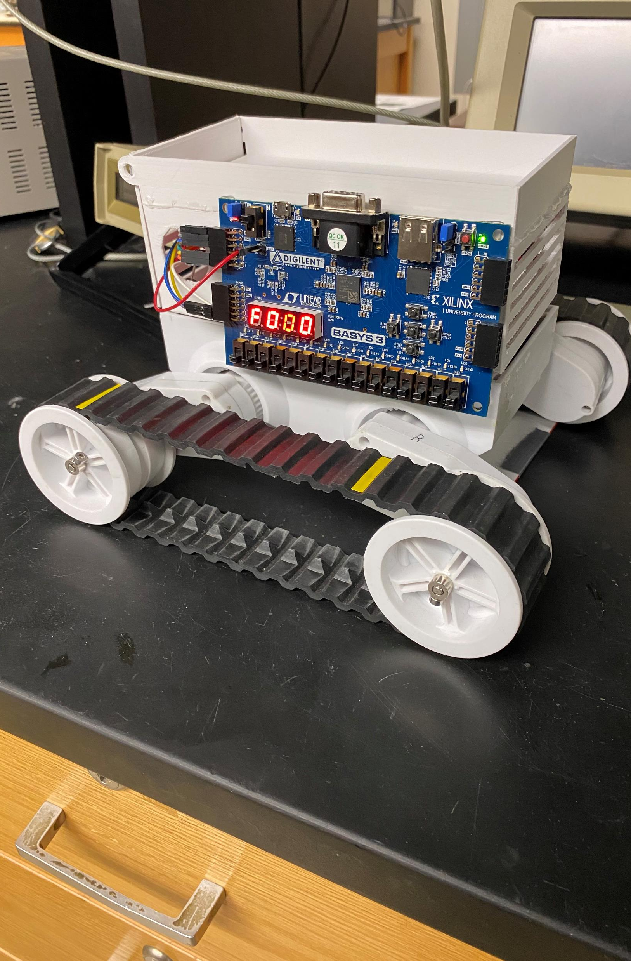
Rover Mini Project
Summary: Use the BASYS 3 board’s built-in switches to control the speed and direction of the motors inside of a rover based on which switch is pulled.
Goals: Build a better understanding of the board, the h-bridge, and the Verilog software.

Slide 3
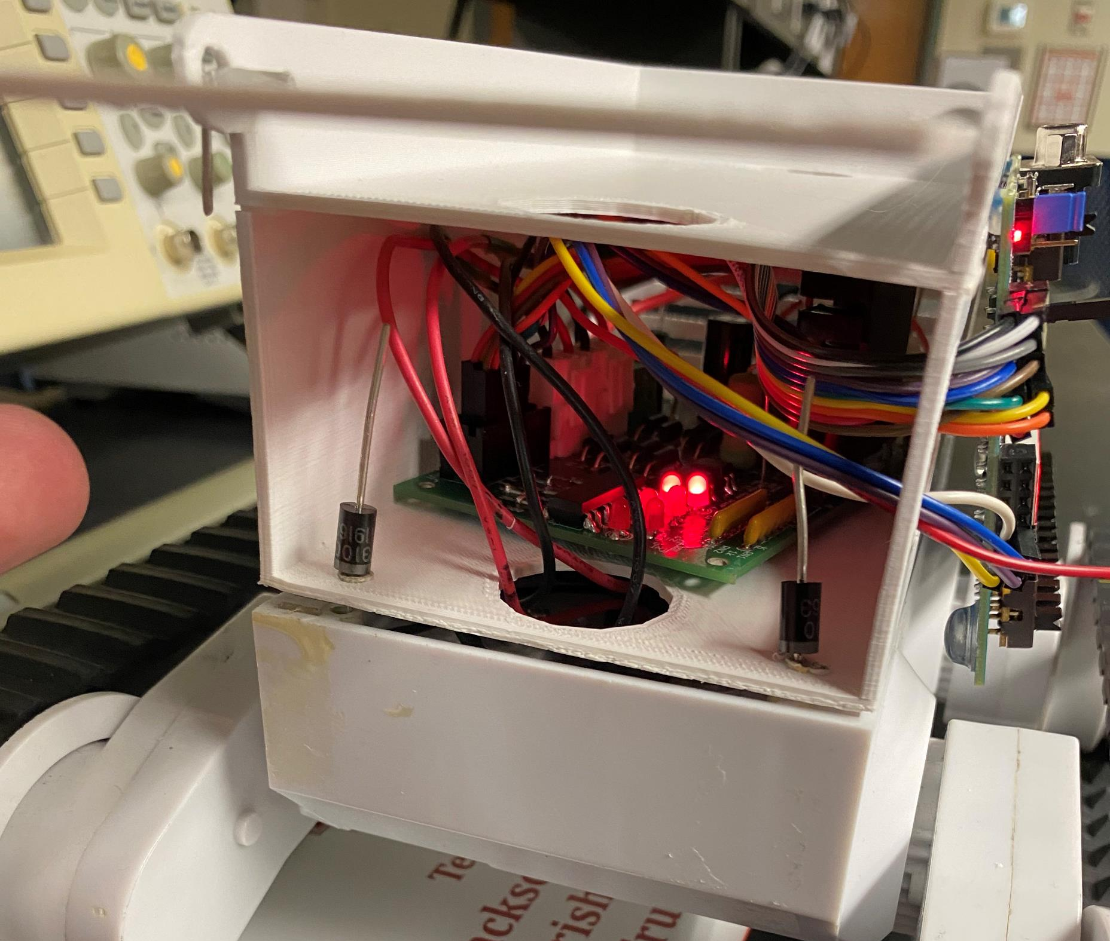
Hardware Update

Slide 4
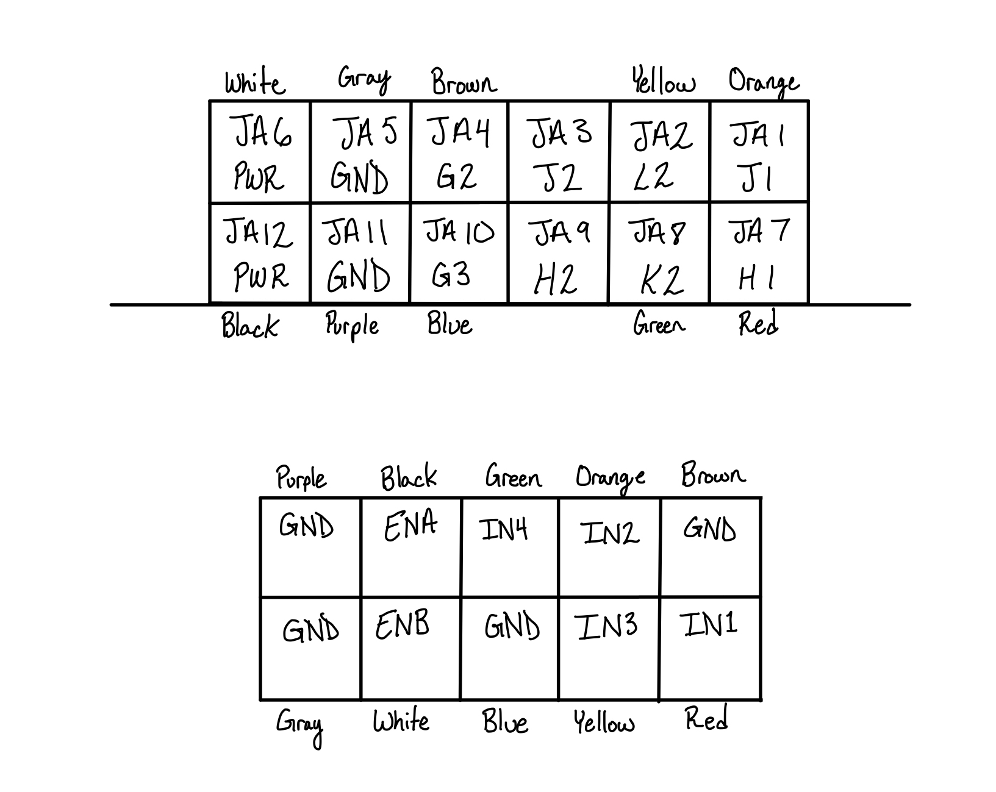
Hardware Update
PMOD

Slide 5
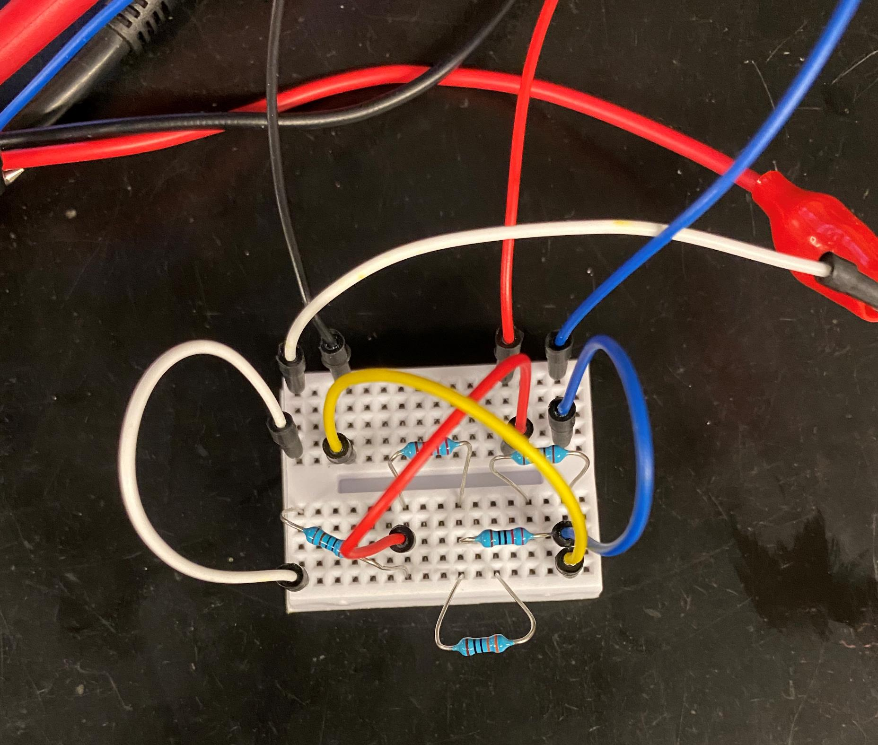
Hardware Update

Slide 6
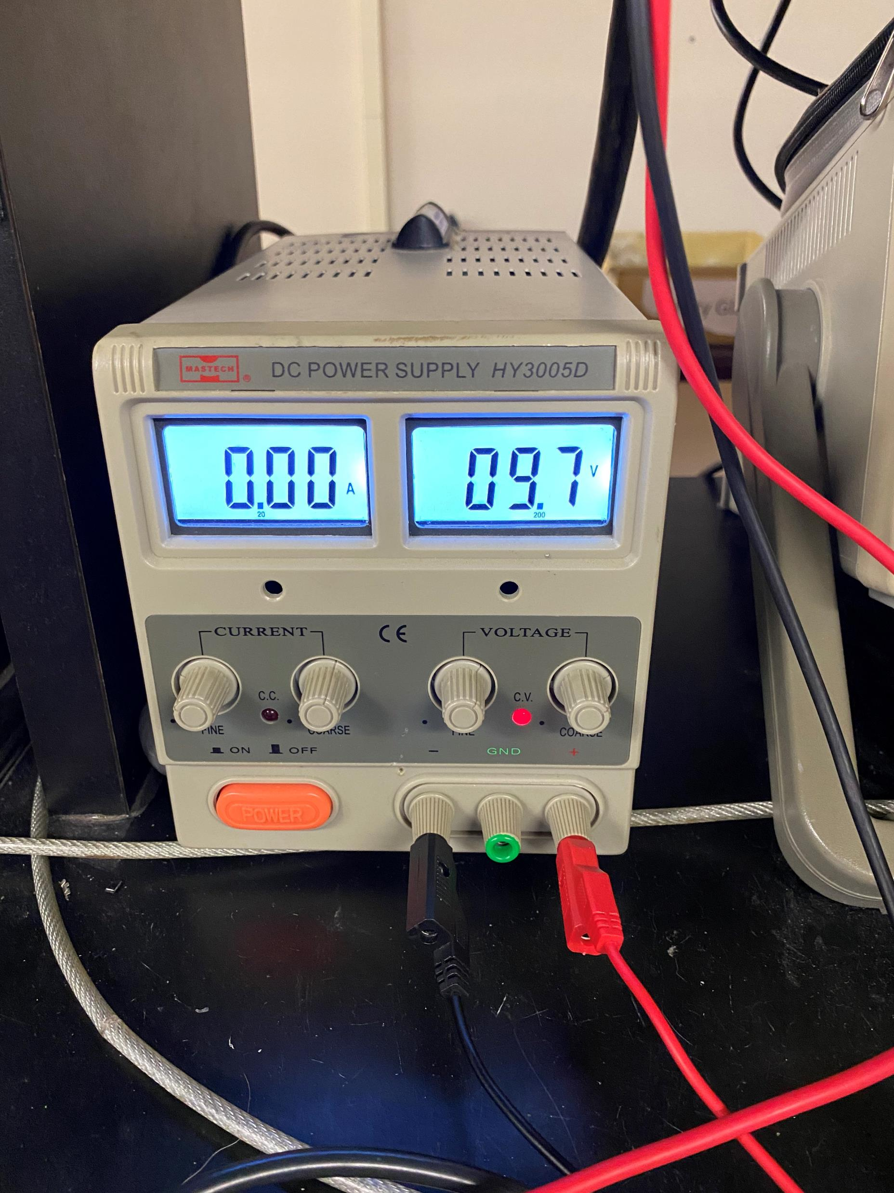
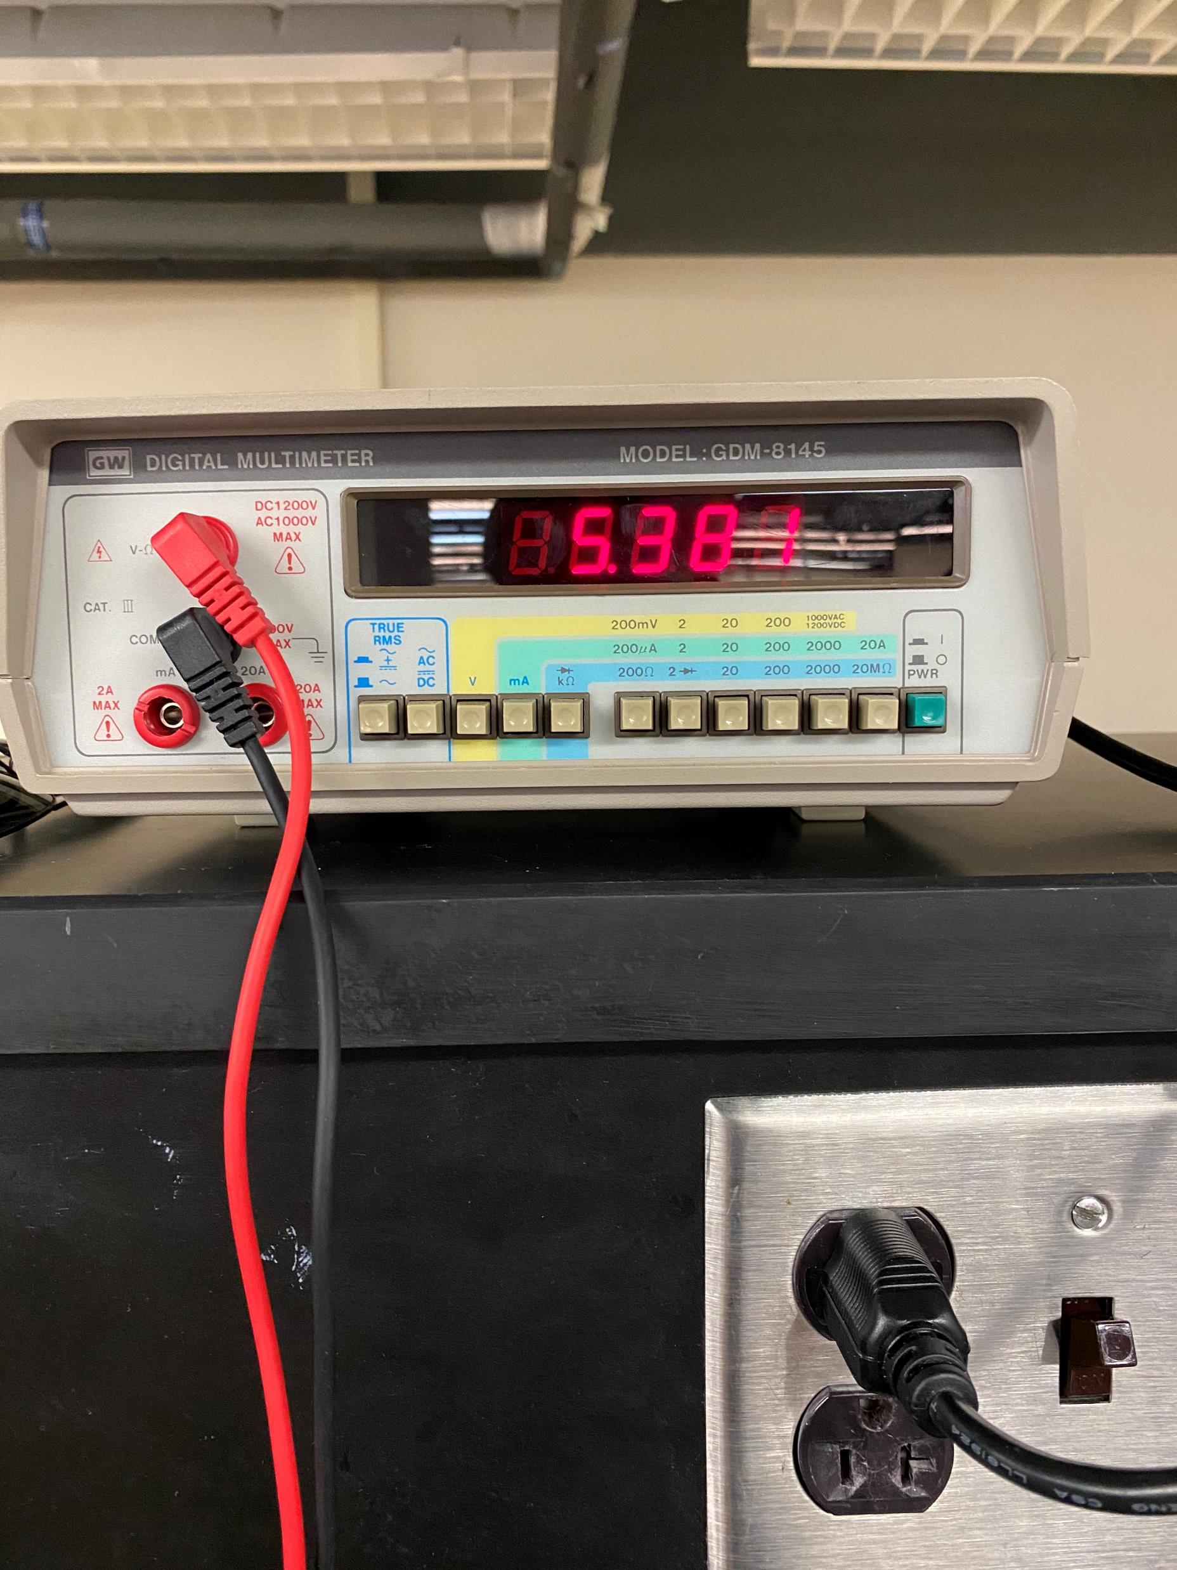
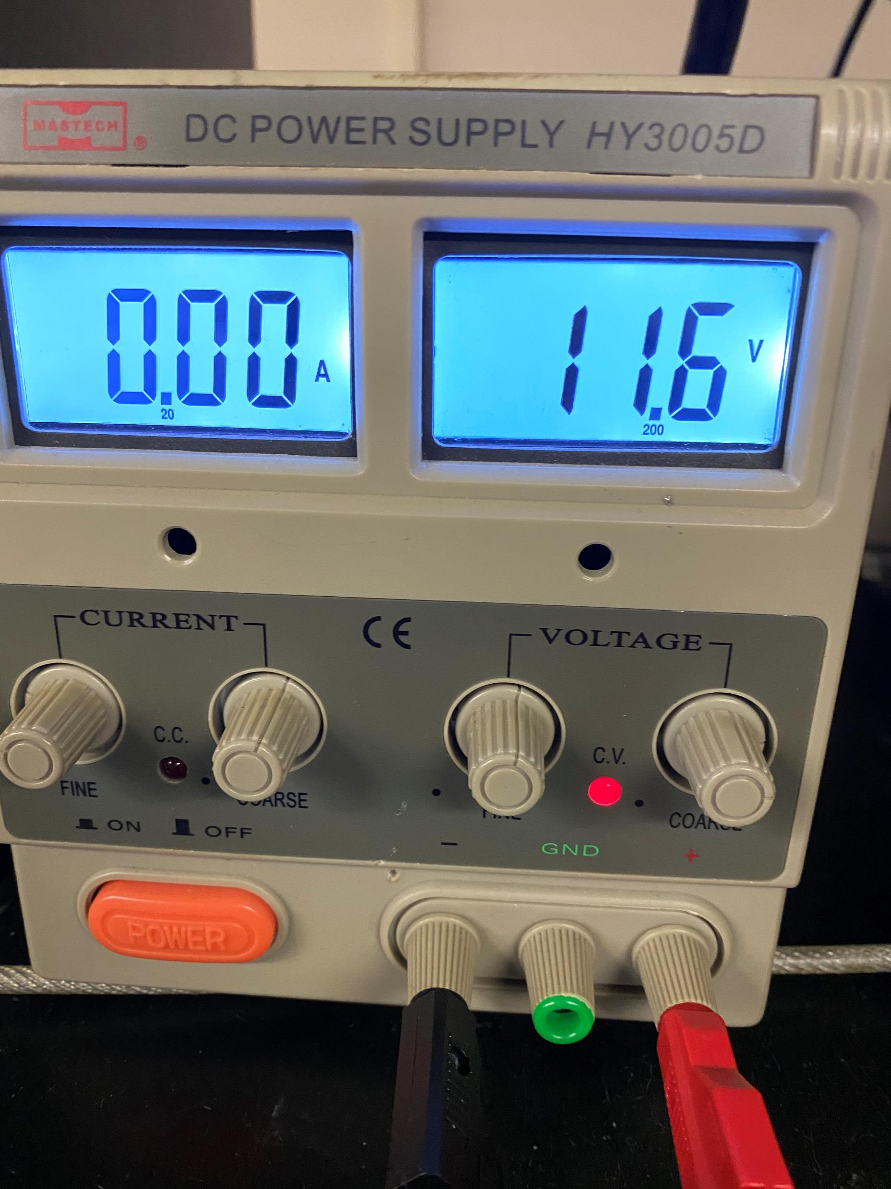
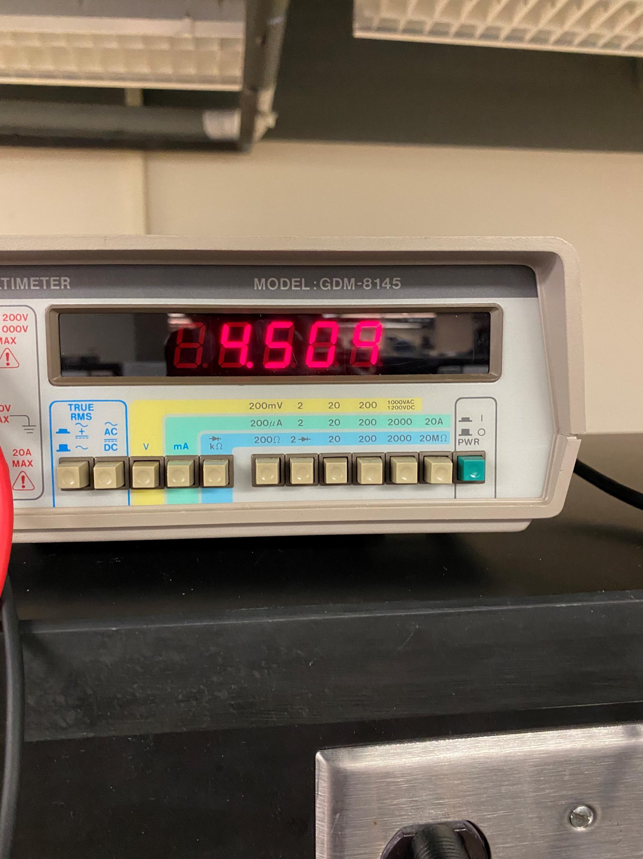
Hardware Update

Slide 7
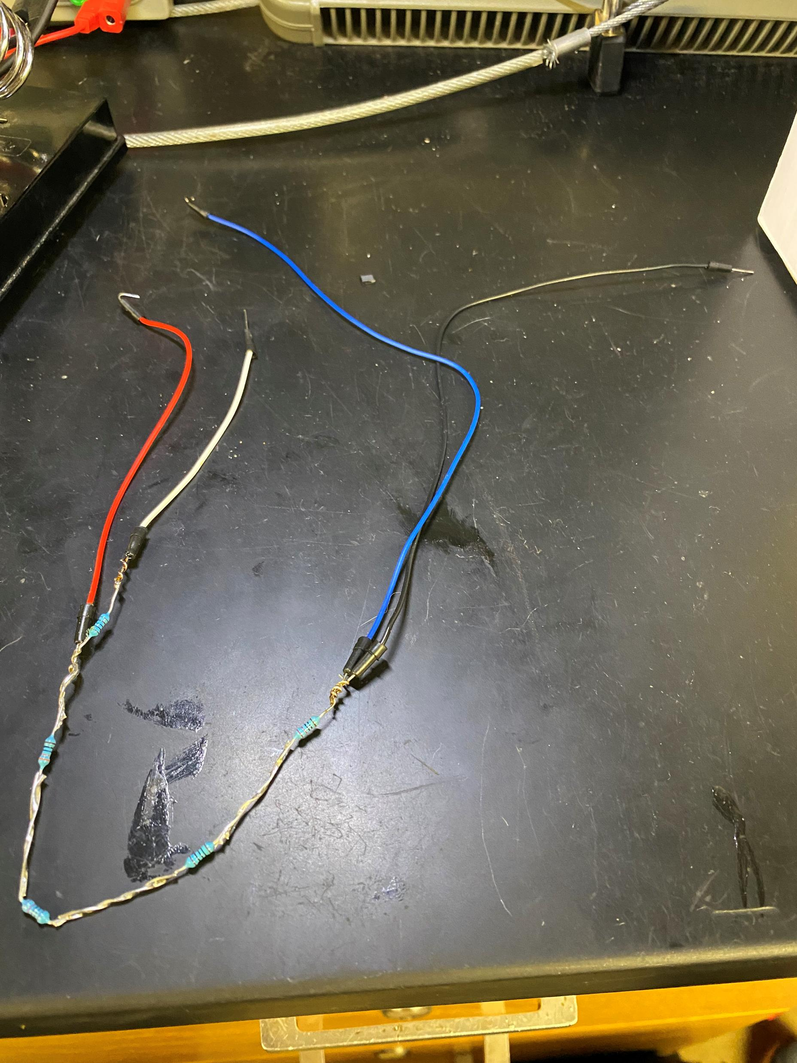
Hardware Update

Slide 8
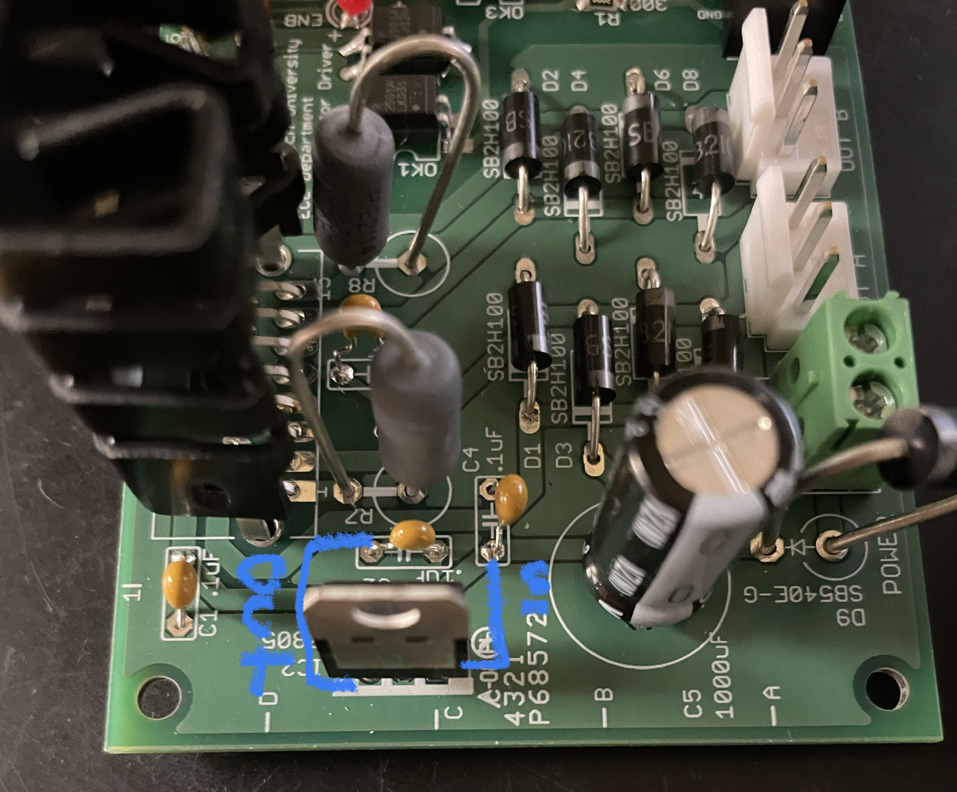
Hardware Update

Slide 9
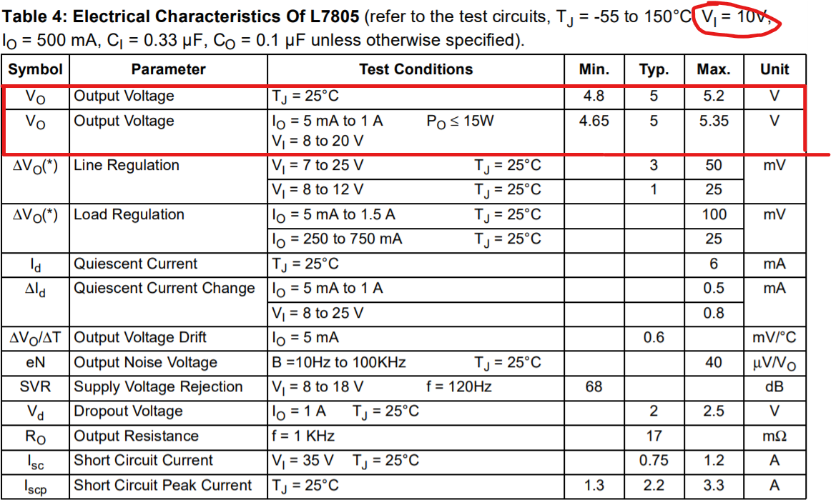
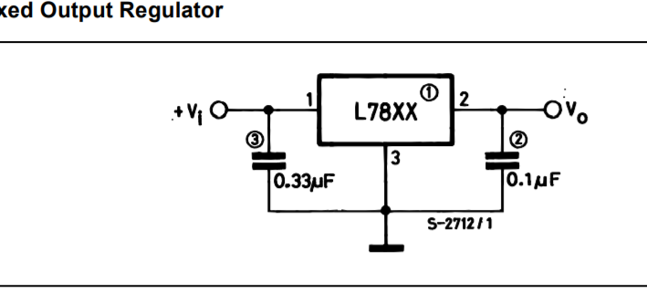
Hardware Update

Slide 10
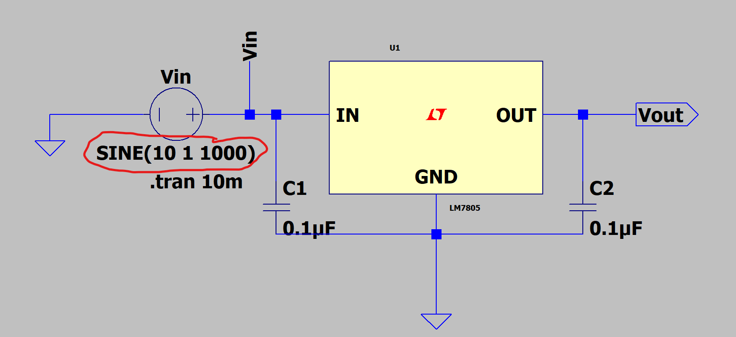
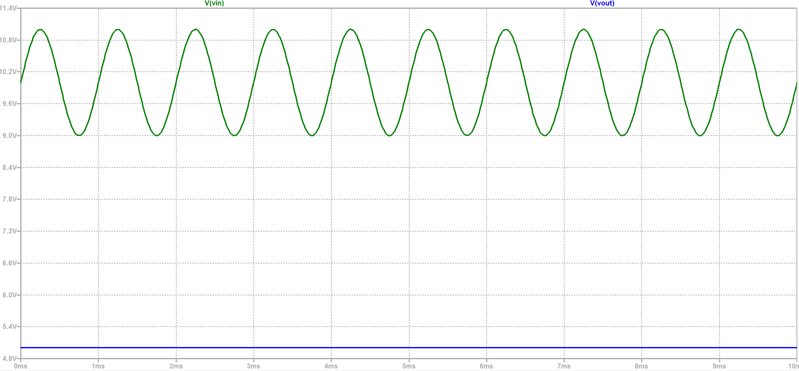
Hardware Update

Slide 11
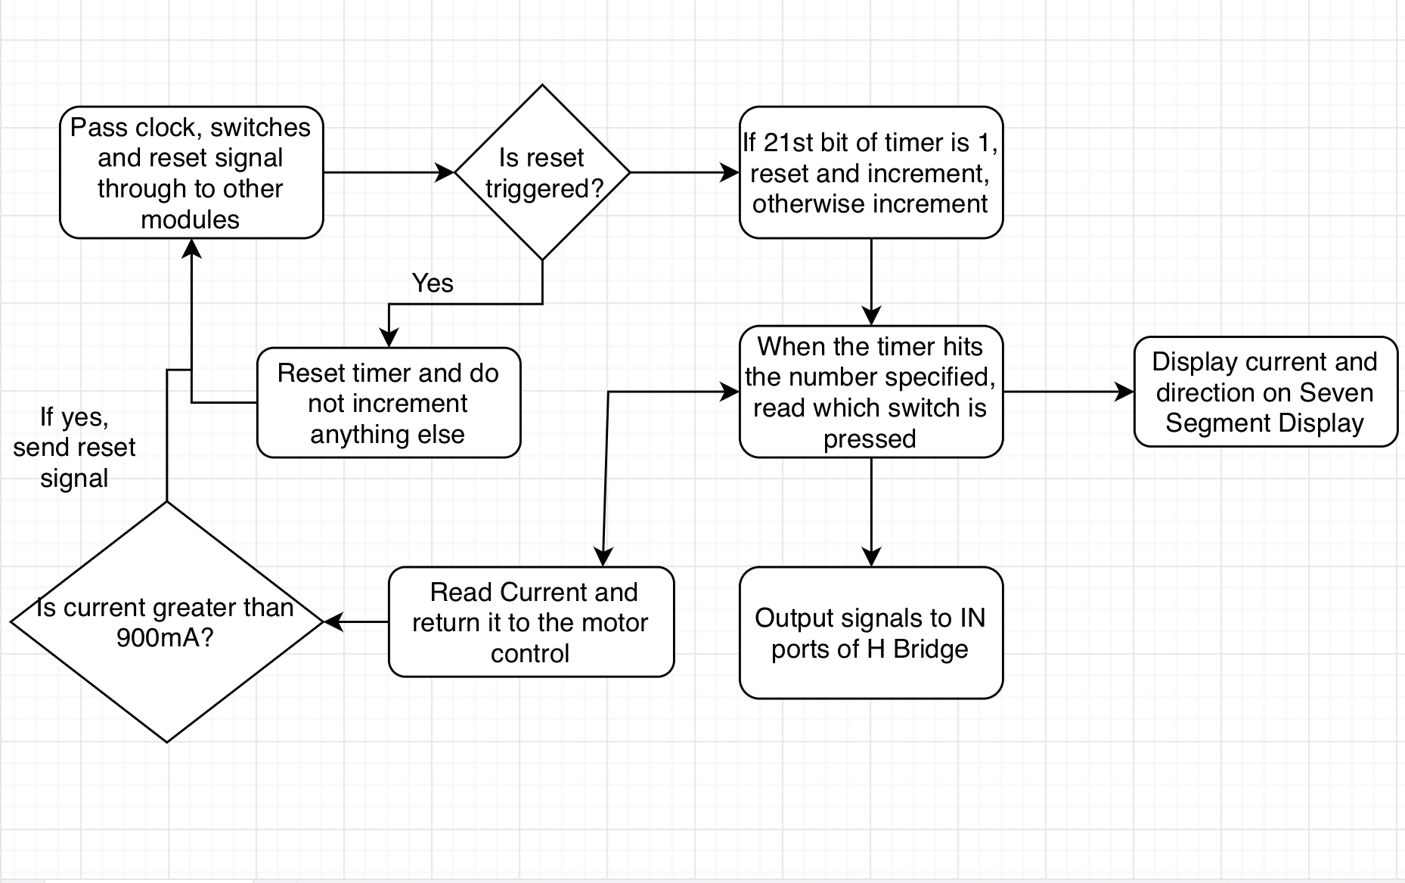
Software Update

Slide 12
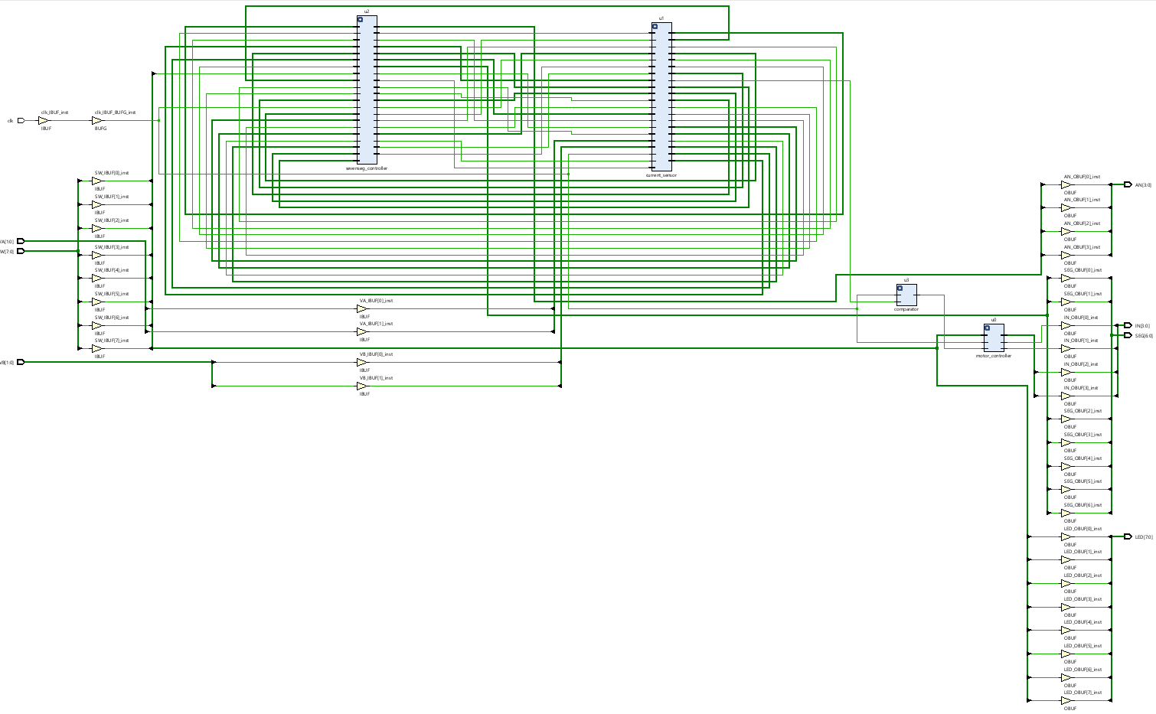
Implementation Schematic

Slide 13
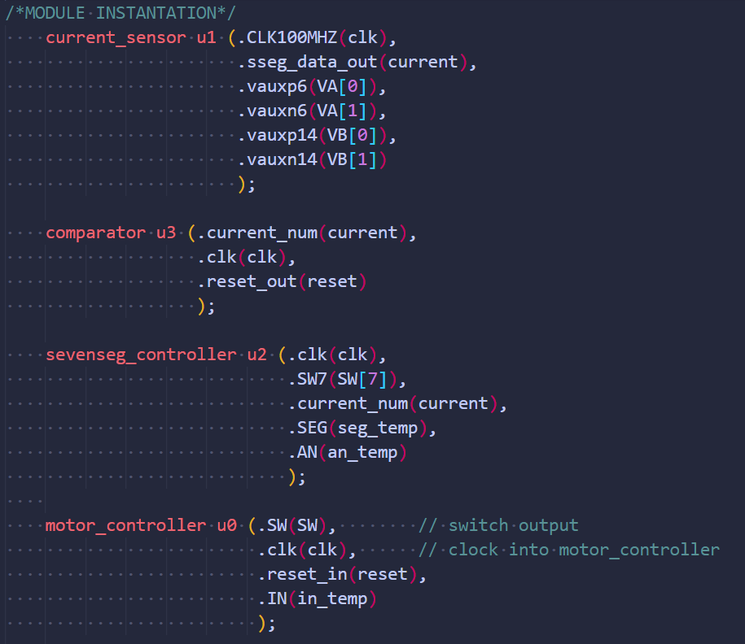
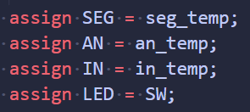
Software Update
Top Module

Slide 14
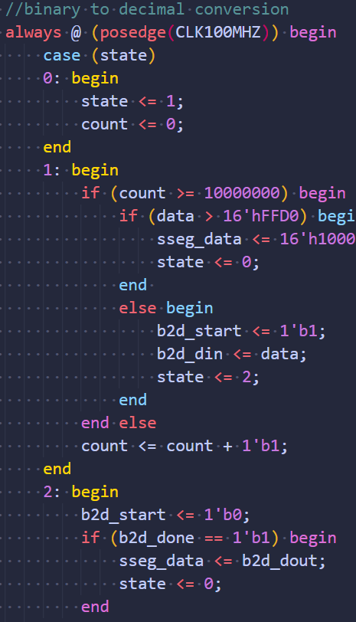
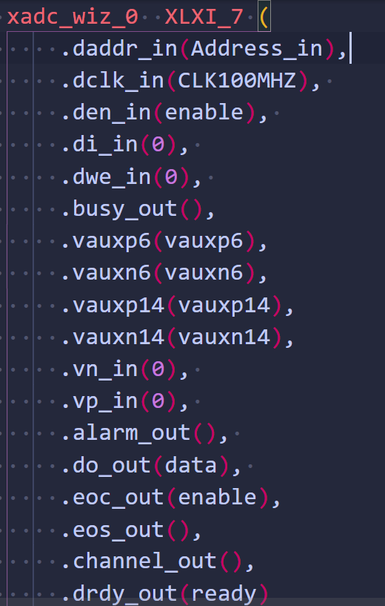
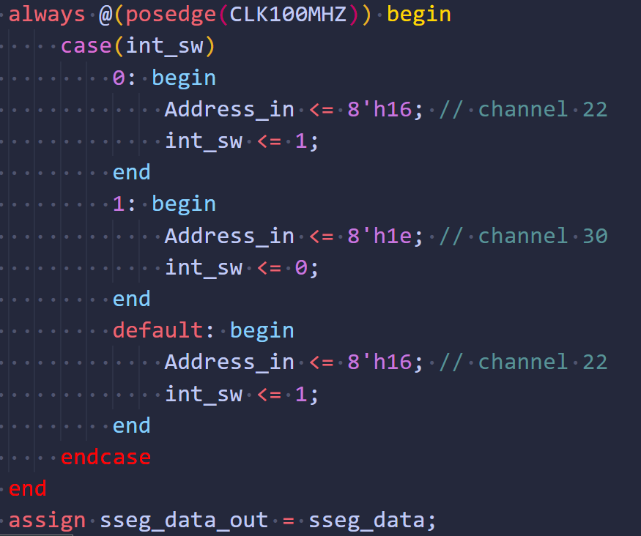
Software Update
Current Sensor

Slide 15
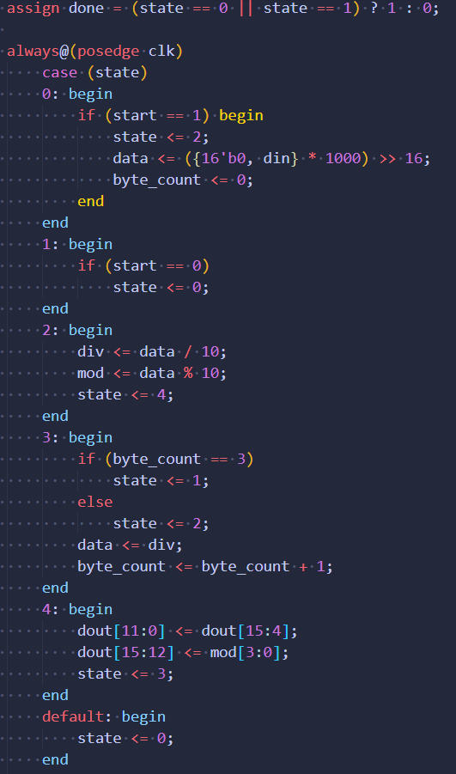
Software Update
Binary to Decimal Converter Module

Slide 16
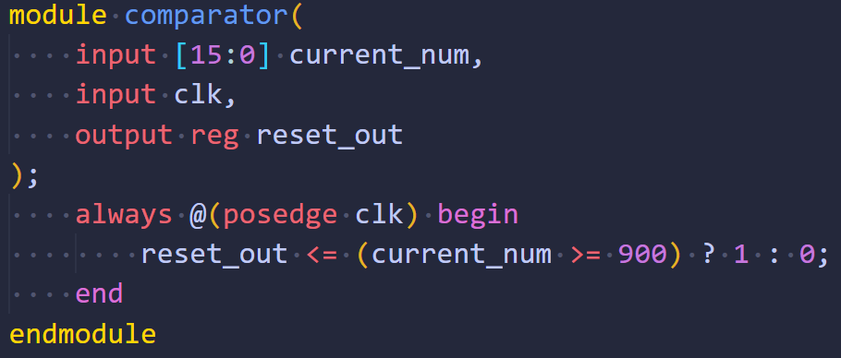
Software Update
Comparator

Slide 17
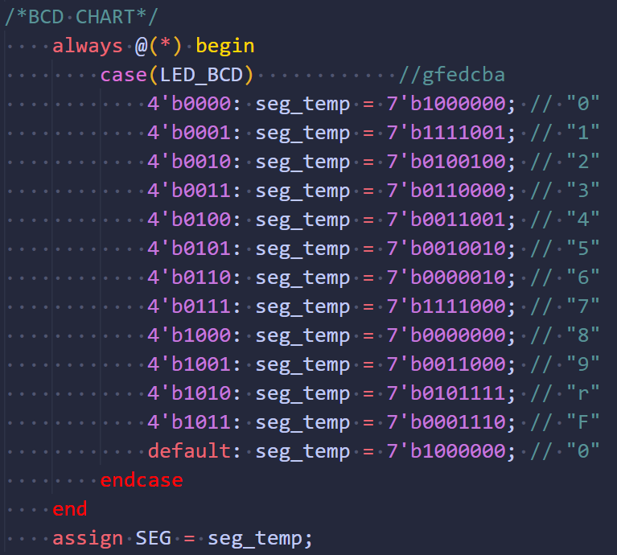
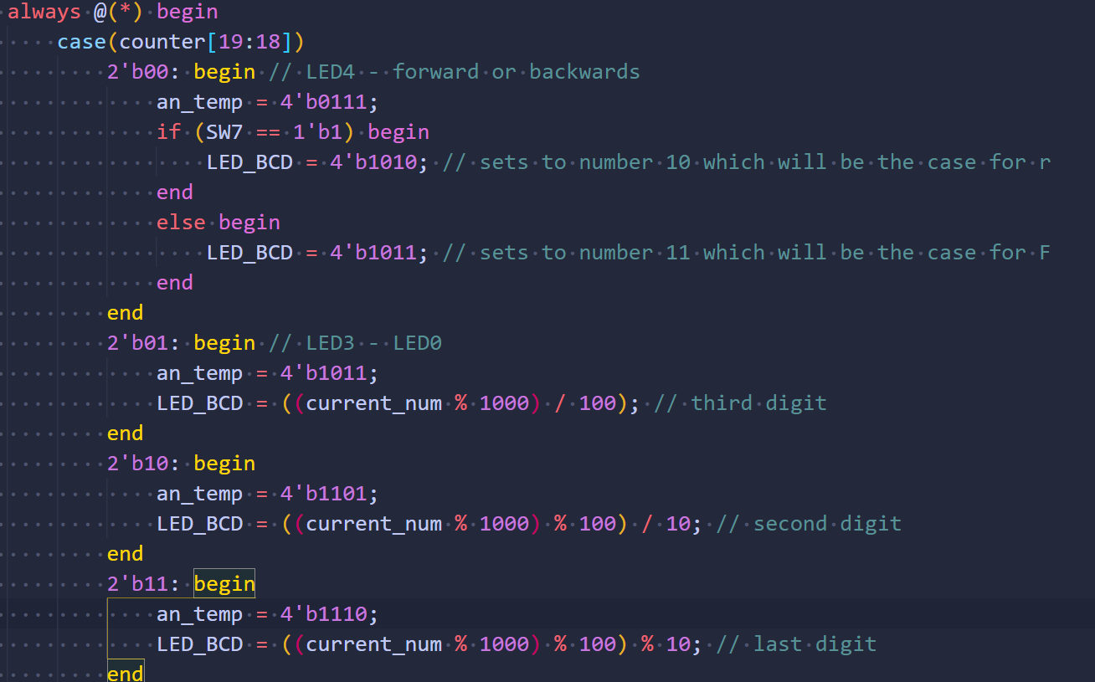
Software Update
Seven Segment Controller Module

Slide 18
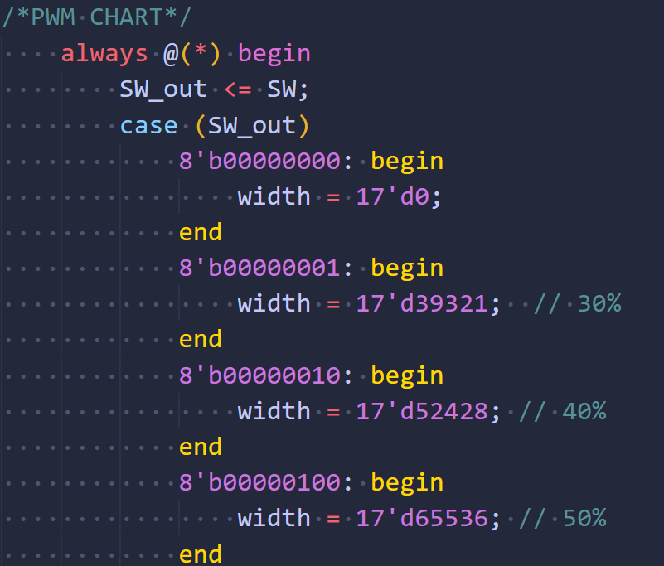
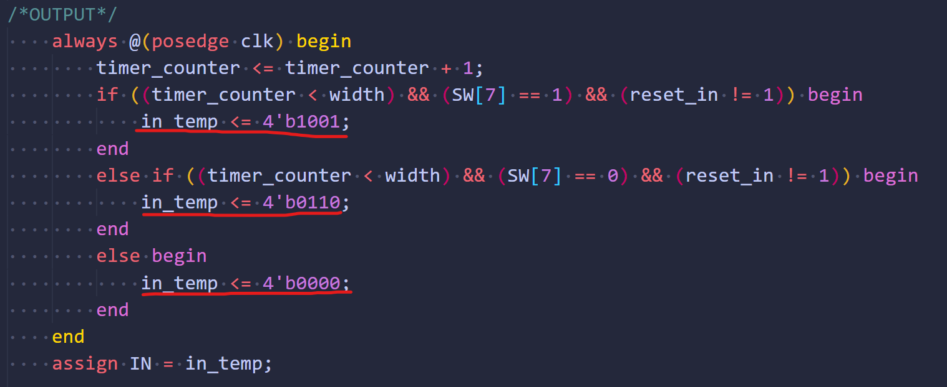
Software Update
Motor Controller

Slide 19
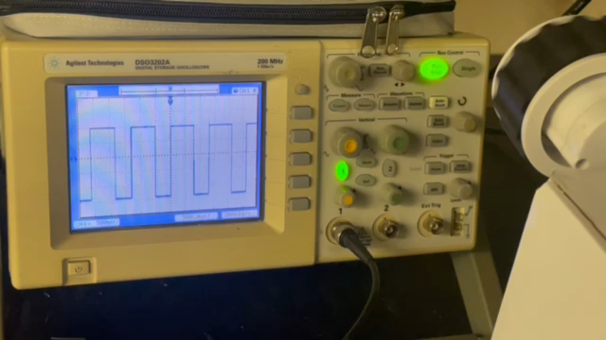
The Rover

Slide 20
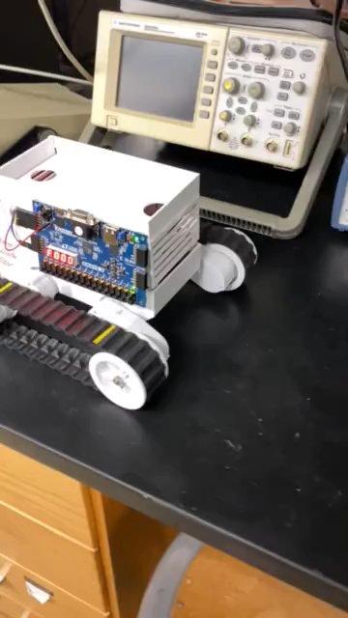
The Rover

Slide 21
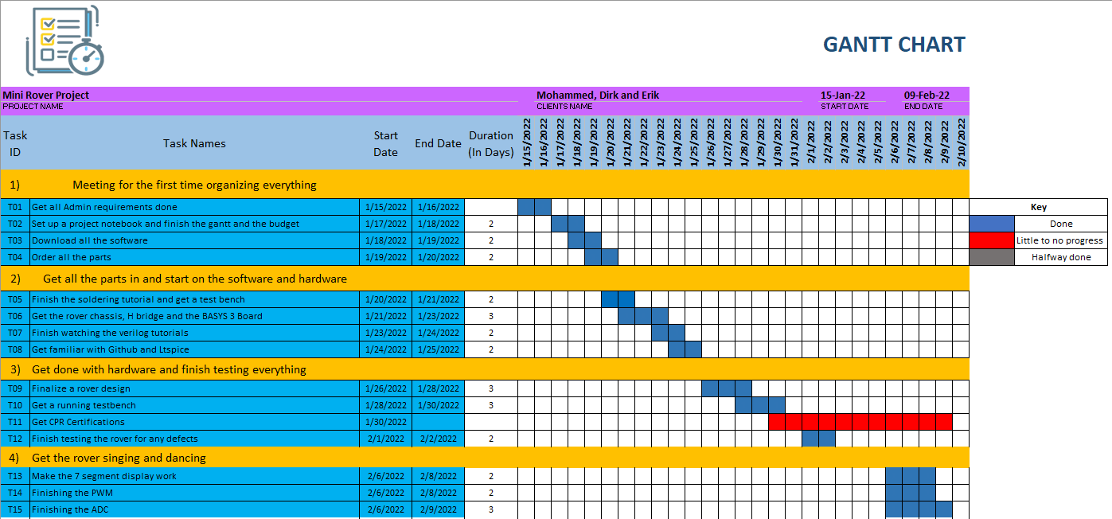
Gantt

Slide 22
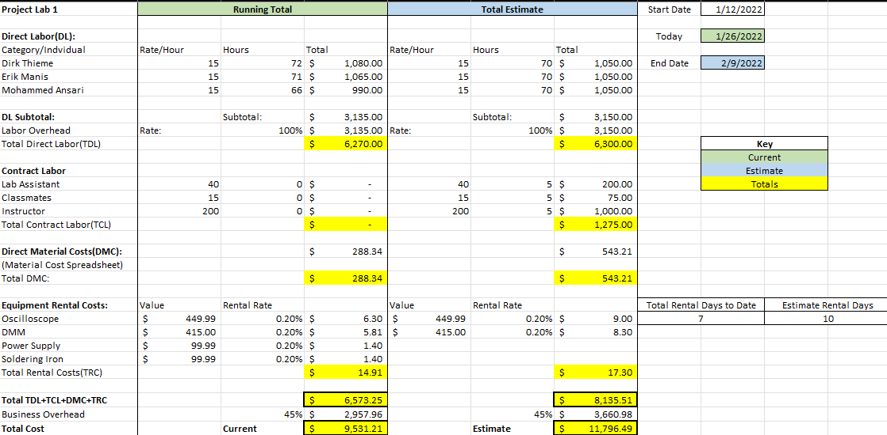
Overall Budget

Slide 23
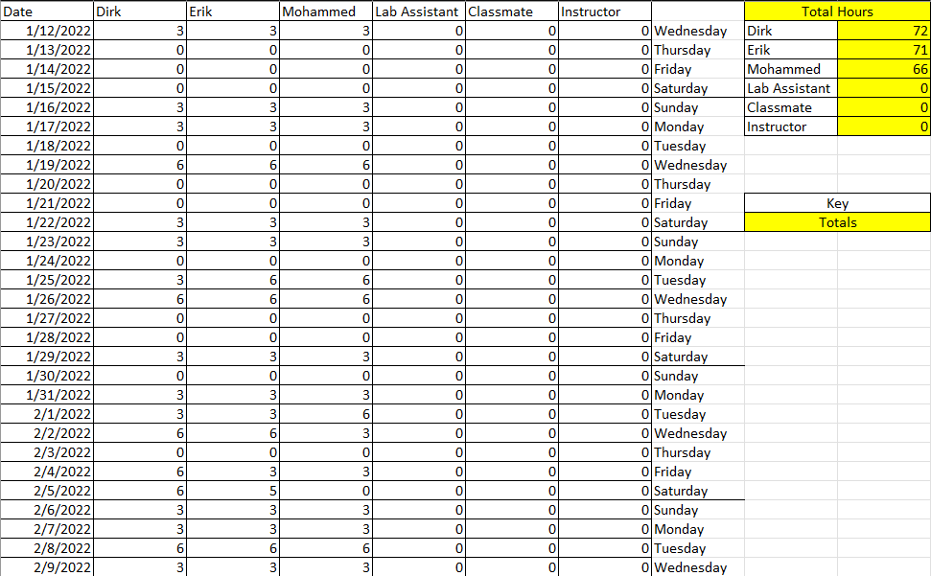
Labor Costs

Slide 24
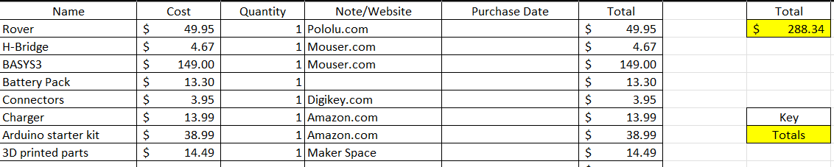
Material Costs

Slide 25

Questions
Software Manager: Dirk Thieme
Hardware Manager: Erik Manis
Project Controller: Mohammed Ansari
This Photo by Unknown author is licensed under CC BY.

